Slide 1
Multigrain Model
Example 5.5

Slide 2
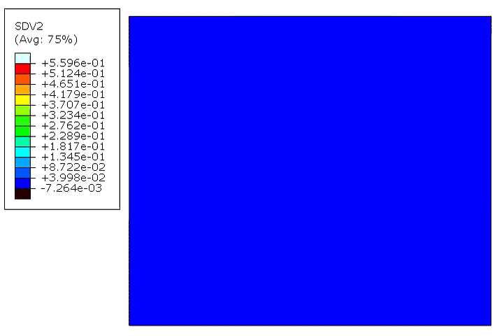
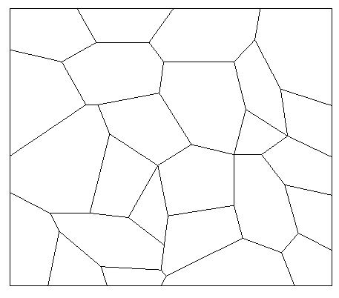

Spinel Formation on Multigrain Model
Numerical result for spinel formation on grain boundary
Notes:
Add experimental image

Slide 3
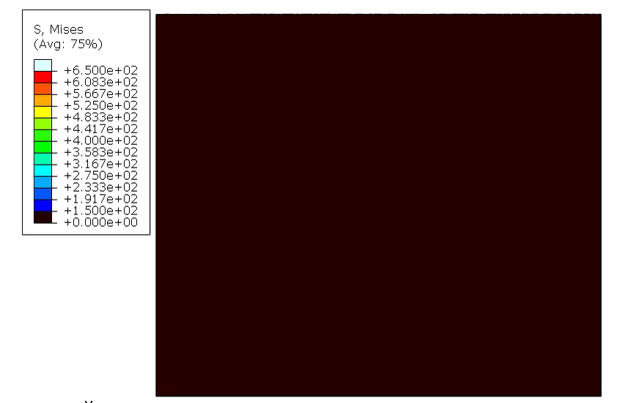
von-Mises Stress

